Slide 1
L1_Analyzing Algorithms
Dr. Jay Dave
CSIS Dept, Hyderabad Campus

Slide 2
Data Structures and Algorithms Design (Merged-SEZG519/SSZG519)
L1_Analyzing Algorithms

Slide 3
Content of L-1
Theoretical Foundation
Algorithms and it’s Specification
Random Access Machine Model
Counting Primitive Operations
Notion of best case, average case and worst case
Characterizing Run Time
Use of asymptotic notation
Big-Oh Notation, Little-Oh, Omega and Theta Notations
Correctness of Algorithms
Analyzing Recursive Algorithms
Recurrence relations
Specifying runtime of recursive algorithms
Solving recurrence equations
Case Study: Analyzing Algorithms

Slide 4

Theoretical Foundation
What are algorithms?
Why is the study of algorithms worthwhile?
What is the role of algorithms relative to other technologies used in computers?

Slide 5
Theoretical Foundation
Informally, an algorithm is any well-defined computational procedure that takes some value, or set of values, as input and produces some value, or set of values, as output.
An algorithm is thus a sequence of computational steps that transform the input into the output.
A tool for solving a well-specified computational problem.

Slide 6
Theoretical Foundation
Data structure
Data: value or set of values. E.g. Rohit, 34, {11,33,2,51}, etc.
Data structure: Logical or mathematical model of particular organization of data is called data structure.
Array: A list of finite number of similar data elements. A[1], A[2], ..., A[N].
Linked List: A list linked to one another.
Stack: A linear list following Last In First Out system (LIFO).
Queue: A linear list following First In First Out system (FIFO).
Graph: A non-linear list consisting vertices and edges.
Tree: A graph without cycles.

Slide 7
Theoretical Foundation
Data structure operations
Traversing
Searching
Inserting
Deleting
Sorting
Merging

Slide 8
Theoretical Foundation
If an algorithm has been implemented, we can study its running time by executing it on various test, inputs and recording the actual time spent in each execution.
Depends on language or operating system or execution environment.
We are interested in determining the dependency of the running time on the size of the input.
One way is that we can perform several experiments on many different test inputs' of various sizes.
The running time is affected by the hardware environment (processor, clock rate, memory, disk, etc.). and software environment (operating system, programming language, compiler, interpreter, etc.) in which the algorithm is implemented, compiled, and executed.

Slide 9
Theoretical Foundation
Limitations of experimental analysis
Experiments can be done only on a limited set of test inputs, and care must be taken to make sure these are representative.
It is difficult to compare the efficiency of two algorithms unless experiments on their running times have been performed in the same hardware and software environments.
It is necessary to implement and execute an algorithm in order to study its running time experimentally.

Slide 10
Theoretical Foundation
We desire an analytic framework that
Takes into account all possible inputs
Allows us to evaluate the relative efficiency of any two algorithms in a way that is independent from the hardware and software environment.
Can be performed by studying a high-level description of the algorithm without actually implementing it or running experiments on it.
This methodology aims at associating with each algorithm a function f(n) that characterizes the running time of the algorithm in terms of the input size n.

Slide 11
Theoretical Foundation
We will learn
A language for describing algorithms
A computational model that algorithms execute within
A metric for measuring algorithm running time
An approach for characterizing running times, including those for recursive algorithms.

Slide 12
Theoretical Foundation
Pseudocode: A mixture of natural language and high-level programming constructs that describe the main ideas behind a generic implementation of a data structure or algorithm.
Expressions: We use standard mathematical symbols to express numeric and Boolean expressions We use the left arrow sign (←) as the assignment operator in assignment statements (equivalent to the = operator in C, C++, and Java) and we use the equal sign (=) as the equality relation in Boolean expressions. (equivalent to the "==" relation in C, C++, and Java).
Method declarations: Algorithm name(paraml , param2 ,...) declares a new method "name" and its parameters.
Decision structures: if condition, then true-actions [else false-actions]. We use indentation to indicate what actions should be included in the true-actions and false-actions.

Slide 13
Theoretical Foundation
While-loops: while condition do actions. We use indentation to indicate what actions should be included in the loop actions
Repeat-loops: repeat actions until condition. We use indentation to indicate whit actions should be included in the loop actions
For-loops for variable-increment-definition do actions We use indentation to indicate what actions should be included among the loop actions
Array indexing: A[i] represents the ith cell in the array A The cells' of an n-celled array A are indexed from A[0] to A[n-1] (consistent with C, C++, and Java).
Method calls: object.method(args) (object is optional if it is understood).
Method returns: return value This operation returns the value specified to the method that calls this one.

Slide 14
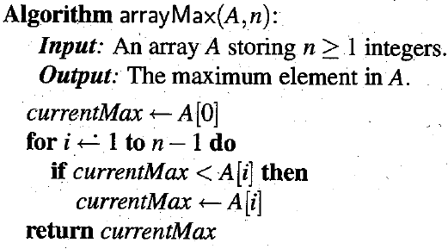
Theoretical Foundation

Slide 15
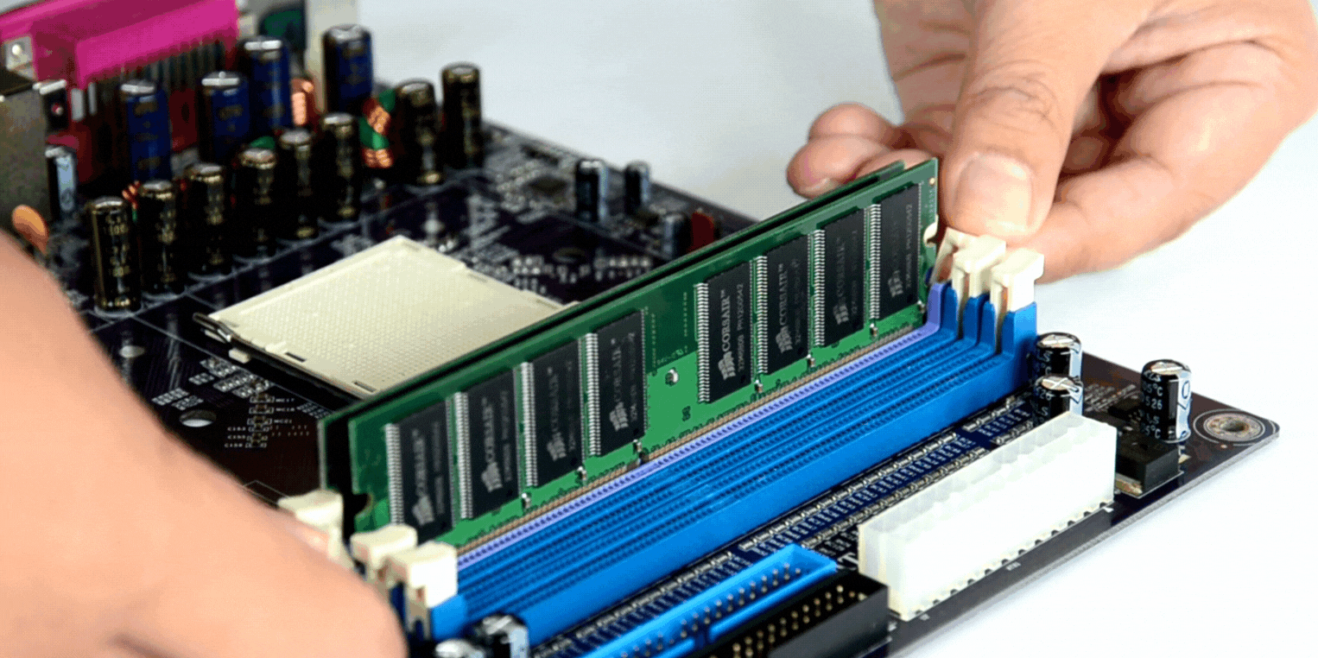
Theoretical Foundation
Random Access Machine (RAM) Model
NO

Slide 16
Theoretical Foundation
Random Access Machine (RAM) Model
As we noted, experimental analysis is valuable, but having limitations.
If we wish to analyze a particular algorithm without performing experiment on running time, we can analyze high-level code or pseudo-code.
High-level primitive operations for pseudo-code:
Assigning a value to variable | Calling a method
Performing an arithmetic operation | Comparing two numbers
Indexing into an array | Following an object reference
Returning from a method

Slide 17
Theoretical Foundation
Random Access Machine (RAM) Model
Depends on hardware/software environment but is constant.
Instead of trying to understand execution time of primitive operations, we simply count the number of operations.
This count correlates to actual execution time in a specific environment.
Here, the assumption is that primitive operations takes almost similar execution time.
We assume that CPU in RAM model can perform any primitive operation in a constant number of steps, which not depends on size of input.

Slide 18
Theoretical Foundation
Counting Primitive Operations
1
n
n-1
0 to n-1
1

Slide 19
Theoretical Foundation
Notion of best case, average case and worst case
Best case: minimum number of primitive operations executed. E.g. max is at the first place in array.
Worst case: maximum number of primitive operations executed. E.g. max is at the last place in array.
Average case: average number of primitive operations executed. E.g. max is in between the first and last places of the array.

Slide 20
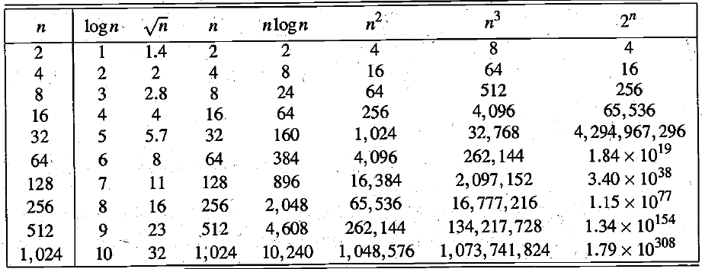
Some Mathematics
Ordering Functions by Their Growth Rates
1 < logn < sqrt(n) ​< n < n logn <n²<n³<…<2^{n}<3^{n} <n^{n}

Slide 21
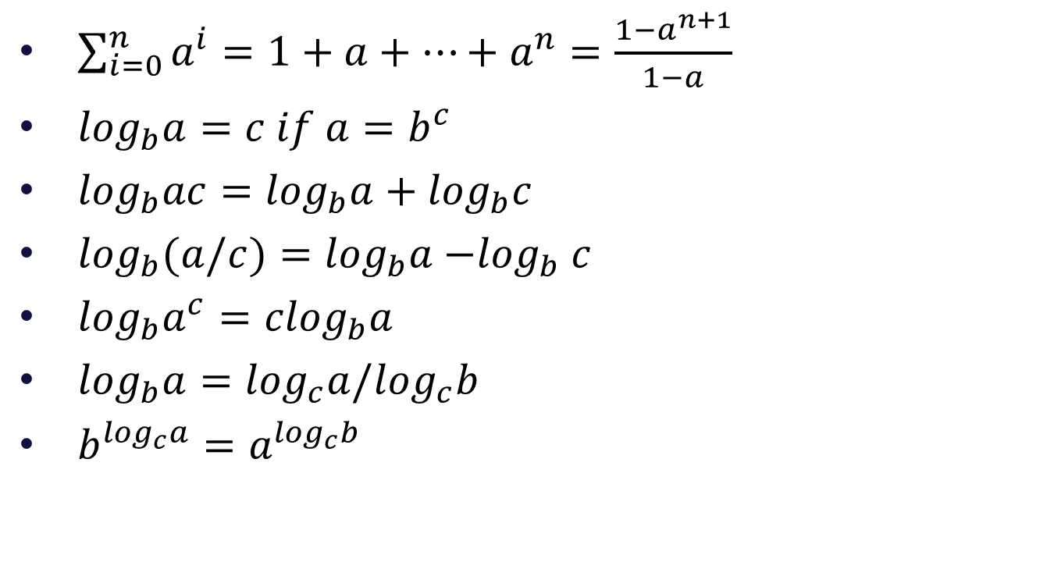
Some Mathematics
$\sum_{i=0}^{n}{a^{i}=1+a+…+a^{n}=\frac{1−a^{n+1}}{1−a}}$
$\log_{b}a=c if a=b^{c}$
$\log_{b}ac=\log_{b}a+\log_{b}c$
$\log_{b}(a/c)=\log_{b}a{−log}_{b}c$
$\log_{b}a^{c}={clog}_{b}a$
$\log_{b}a=\log_{c}a/\log_{c}b$
$b^{\log_{c}a}=$ $a^{\log_{c}b}$

Slide 22
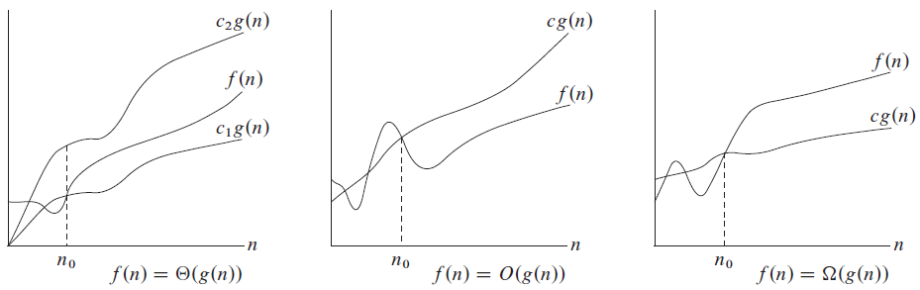
Characterizing Run Time
Big-Oh Notation, Little-Oh, Omega and Theta Notations:
Asymptotic notation primarily to describe the running times of algorithms

Slide 23
Characterizing Run Time
Big-Oh Notation: f(n) = O(g(n)).
g(n) is an asymptotically upper bound for f(n).
f(n) = ϴ(g(n)) implies that f(n) = O(g(n)),
i.e., ϴ(g(n)) ϵ O(g(n))

Slide 24
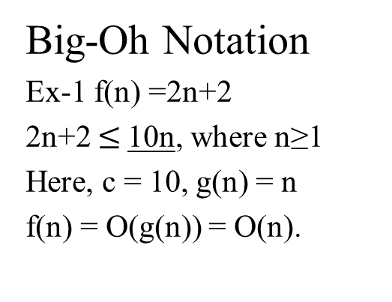
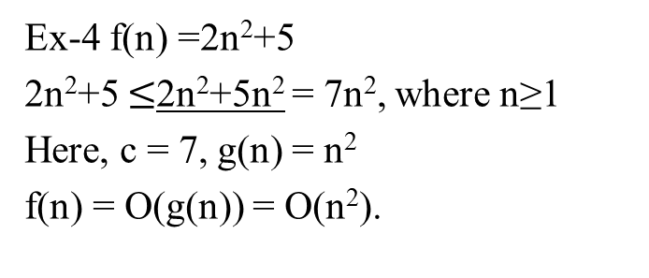
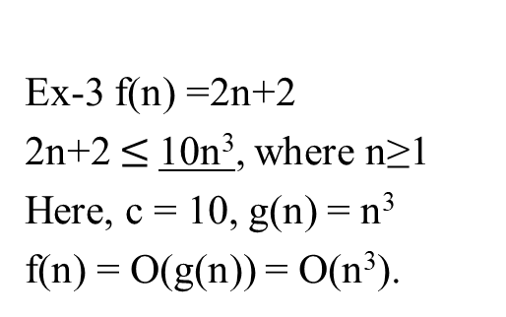
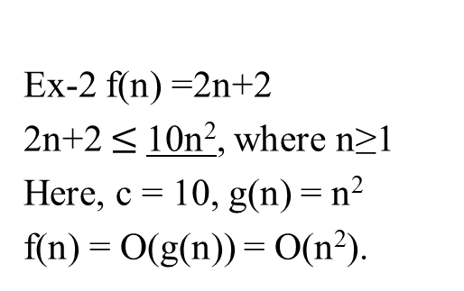
Characterizing Run Time
Big-Oh Notation
Ex-1 f(n) =2n+2
2n+2 $≤$10n, where n≥1
Here, c = 10, g(n) = n
f(n) = O(g(n)) = O(n).
Ex-2 f(n) =2n+2
2n+2 $≤$10n², where n≥1
Here, c = 10, g(n) = n²
f(n) = O(g(n)) = O(n²).
Ex-3 f(n) =2n+2
2n+2 $≤$10n³, where n≥1
Here, c = 10, g(n) = n³
f(n) = O(g(n)) = O(n³).
Ex-4 f(n) =2n²+5
2n²+5 $≤$2n²+5n² = 7n², where n≥1
Here, c = 7, g(n) = n²
f(n) = O(g(n)) = O(n²).

Slide 25
Characterizing Run Time
Omega Notation: f(n) = Ω(g(n)).
g(n) is an asymptotically lower bound for f(n).

Slide 26
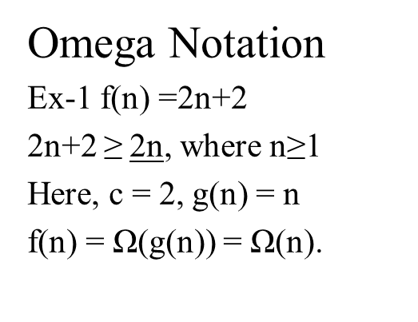
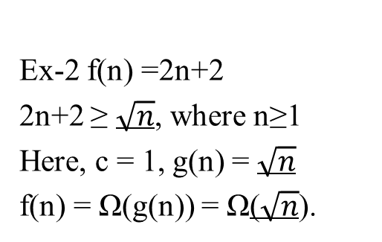
Characterizing Run Time
Omega Notation
Ex-1 f(n) =2n+2
2n+2 ≥ 2n, where n≥1
Here, c = 2, g(n) = n
f(n) = Ω(g(n)) = Ω(n).
Ex-2 f(n) =2n+2
2n+2 ≥ $\sqrt{n}$, where n≥1
Here, c = 1, g(n) = $\sqrt{n}$
f(n) = Ω(g(n)) = Ω($\sqrt{n}$).
Ex-3 f(n) =2n+2
2n+2 ≥ log n, where n≥1
Here, c = 1, g(n) = log n
f(n) = Ω(g(n)) = Ω(log n).
Ex-4 f(n) =2n²+5
2n²+5 ≥ 2n², where n≥1
Here, c = 2, g(n) = n²
f(n) = Ω(g(n)) = Ω(n²).

Slide 27
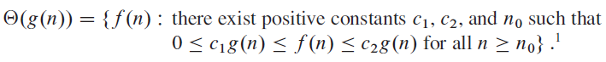
Characterizing Run Time
Theta Notation: f(n) = ϴ(g(n)).
g(n) is an asymptotically tight bound for f(n).

Slide 28
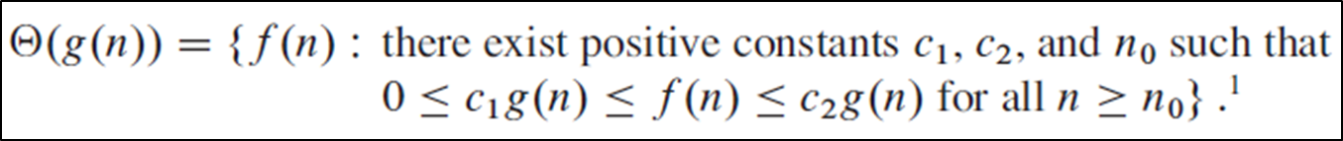
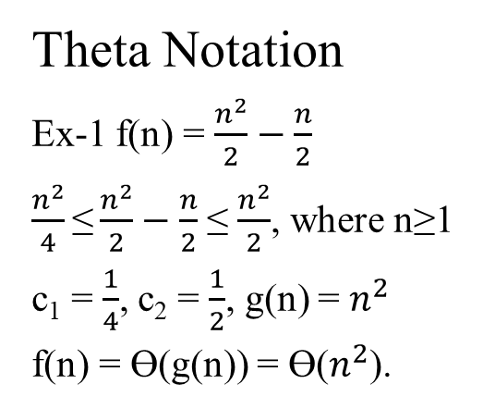
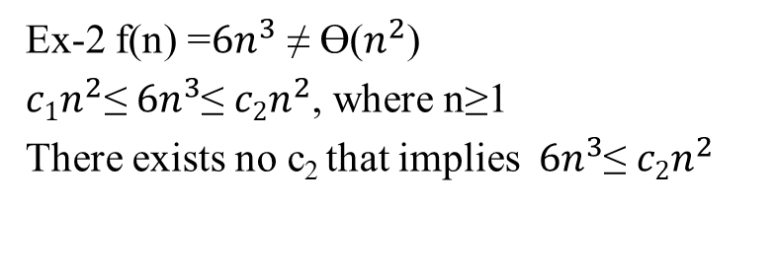
Characterizing Run Time
Theta Notation
Ex-1 f(n) = $\frac{n^{2}}{2}−\frac{n}{2}$
$\frac{n^{2}}{4}\text{≤}\frac{n^{2}}{2}−\frac{n}{2}$ ≤$\frac{n^{2}}{2}$, where n≥1
c₁ = $\frac{1}{4}$, c₂ = $\frac{1}{2}$, g(n) = $n^{2}$
f(n) = ϴ(g(n)) = ϴ($n^{2}$).
Ex-2 f(n) =${6n}^{3}$ ≠ ϴ($n^{2}$)
$c1n^{2}\text{≤}{ 6n}^{3}$≤ $c2n^{2}$, where n≥1
There exists no c₂ that implies ${ 6n}^{3}$≤ $c2n^{2}$

Slide 29
Characterizing Run Time
Big-Oh Notation, Little-Oh, Omega and Theta Notations
o-notation:
w-notation:

Slide 30
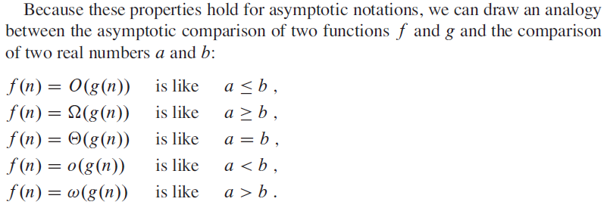
Characterizing Run Time
Big-Oh Notation, Little-Oh, Omega and Theta Notations
Summary

Slide 31
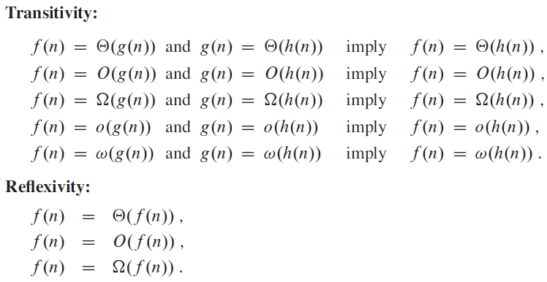
Characterizing Run Time
Big-Oh Notation, Little-Oh, Omega and Theta Notations
Comparison

Slide 32
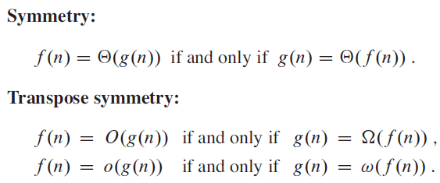
Characterizing Run Time
Big-Oh Notation, Little-Oh, Omega and Theta Notations
Comparison

Slide 33
Correctness of Algorithms
An algorithm is said to be correct if, for every input instance, it halts with the correct output.
We say that a correct algorithm solves the given computational problem.
An incorrect algorithm might not halt at all on some input instances, or it might halt with an incorrect answer.

Slide 34
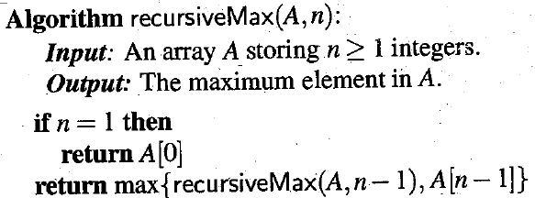
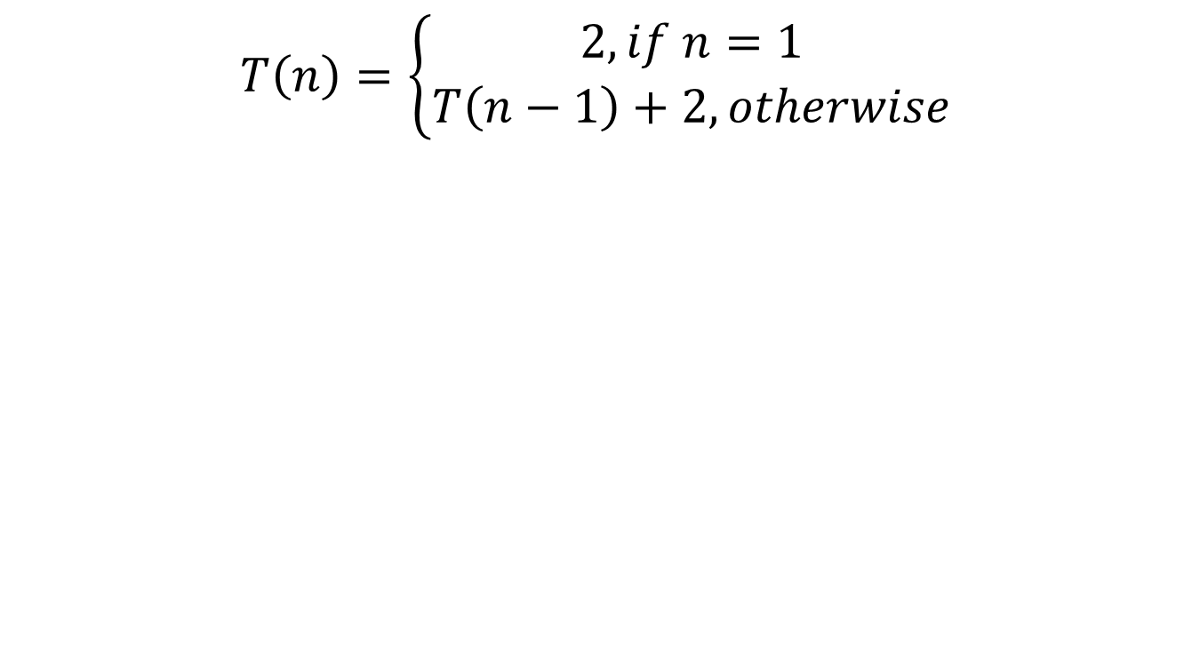
Analyzing Recursive Algorithms
$$T\left(n\right)=\left\{\begin{aligned}2, if n=1 \\ T\left(n−1\right)+2, otherwise\end{aligned}\right.$$

Slide 35
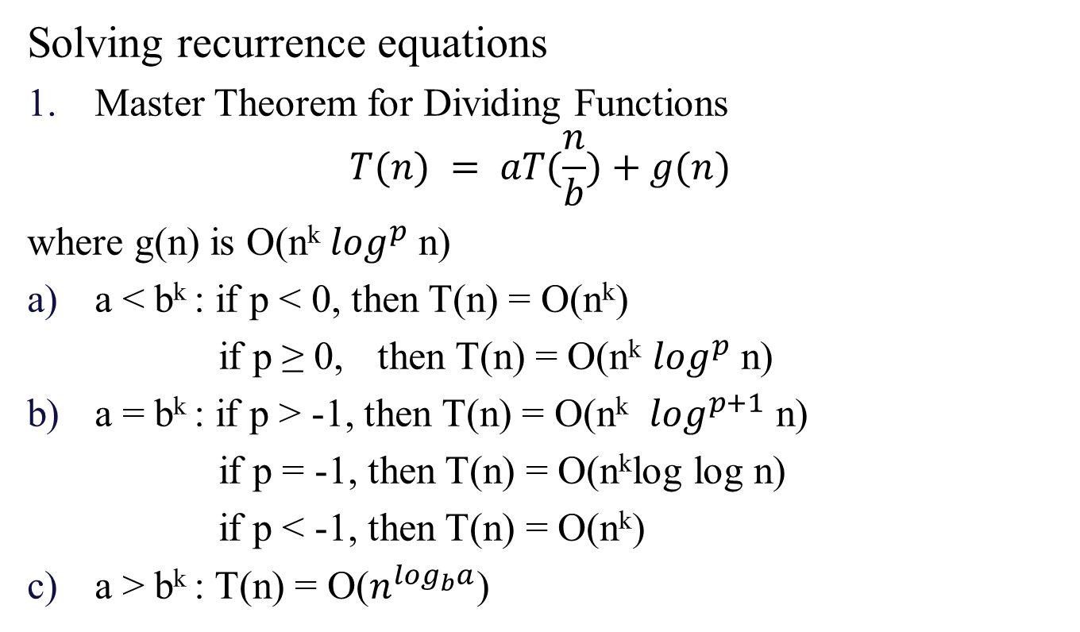
Analyzing Recursive Algorithms
Solving recurrence equations
Master Theorem for Dividing Functions
$$T(n) = aT(\frac{n}{b})+g(n)$$
where g(n) is O(n^{k}$\log^{p}$ n)
a < b^{k} : if p < 0, then T(n) = O(n^{k})
if p ≥ 0, then T(n) = O(n^{k} $\log^{p}$ n)
a = b^{k} : if p > -1, then T(n) = O(n^{k} $\log^{p+1}$ n)
if p = -1, then T(n) = O(n^{k}log log n)
if p < -1, then T(n) = O(n^{k})
a > b^{k} : T(n) = O($n^{\log_{b}a}$)

Slide 36
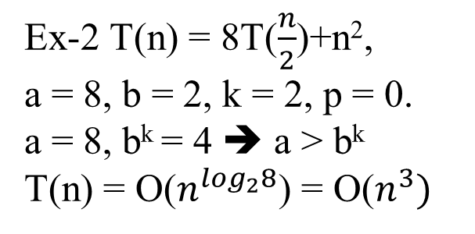
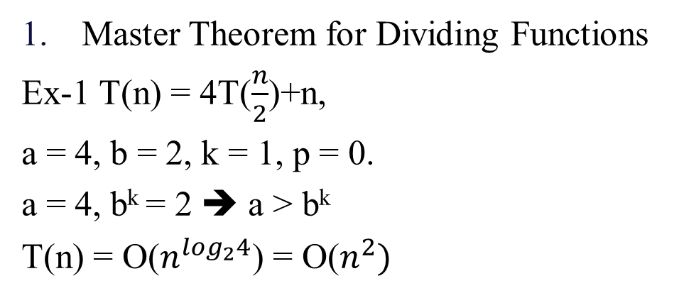
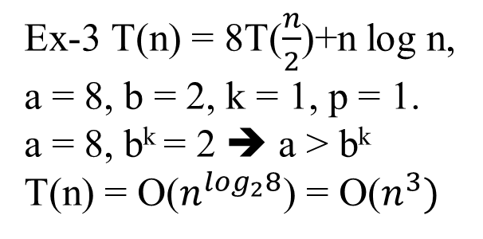
Analyzing Recursive Algorithms
Master Theorem for Dividing Functions
Ex-1 T(n) = 4T($\frac{n}{2}$)+n,
a = 4, b = 2, k = 1, p = 0.
a = 4, b^{k} = 2 ➔ a > b^{k}
T(n) = O($n^{\log_{2}4}$) = O($n^{2})$
Ex-3 T(n) = 8T($\frac{n}{2}$)+n log n,
a = 8, b = 2, k = 1, p = 1.
a = 8, b^{k} = 2 ➔ a > b^{k}
T(n) = O($n^{\log_{2}8}$) = O($n^{3})$
Ex-2 T(n) = 8T($\frac{n}{2}$)+n²,
a = 8, b = 2, k = 2, p = 0.
a = 8, b^{k} = 4 ➔ a > b^{k}
T(n) = O($n^{\log_{2}8}$) = O($n^{3})$

Slide 37
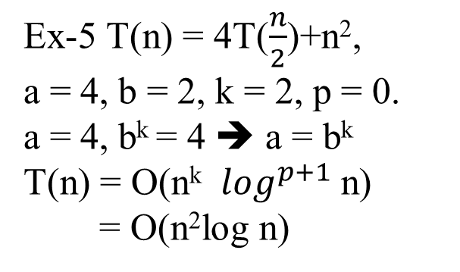
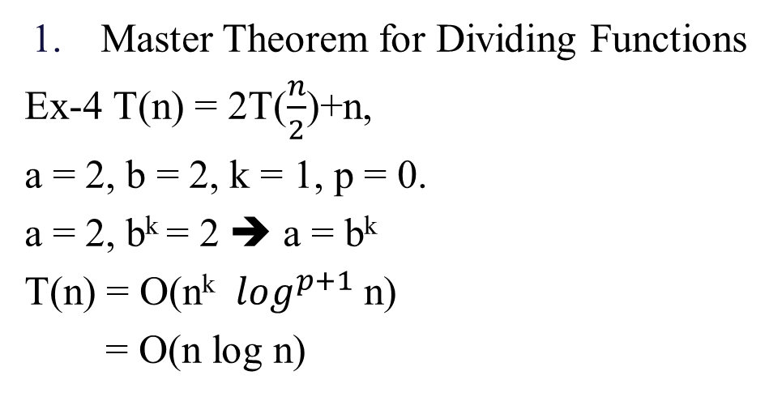
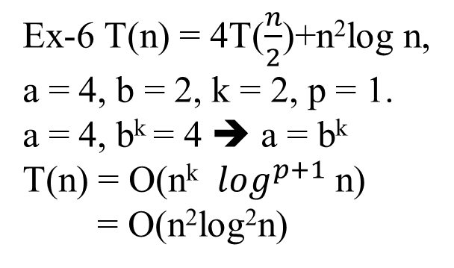
Analyzing Recursive Algorithms
Master Theorem for Dividing Functions
Ex-4 T(n) = 2T($\frac{n}{2}$)+n,
a = 2, b = 2, k = 1, p = 0.
a = 2, b^{k} = 2 ➔ a = b^{k}
T(n) = O(n^{k} $\log^{p+1}$ n)
= O(n log n)
Ex-6 T(n) = 4T($\frac{n}{2}$)+n²log n,
a = 4, b = 2, k = 2, p = 1.
a = 4, b^{k} = 4 ➔ a = b^{k}
T(n) = O(n^{k} $\log^{p+1}$ n)
= O(n²log²n)
Ex-5 T(n) = 4T($\frac{n}{2}$)+n²,
a = 4, b = 2, k = 2, p = 0.
a = 4, b^{k} = 4 ➔ a = b^{k}
T(n) = O(n^{k} $\log^{p+1}$ n)
= O(n²log n)

Slide 38
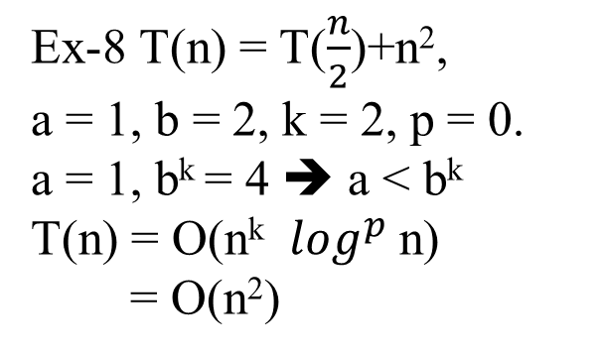
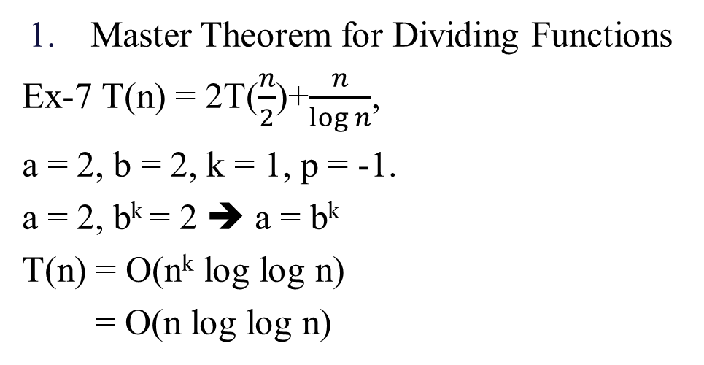
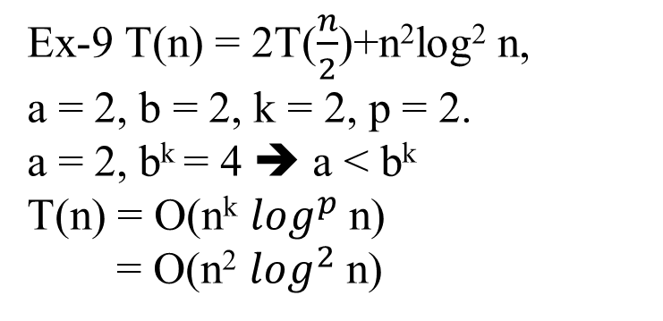
Analyzing Recursive Algorithms
Master Theorem for Dividing Functions
Ex-7 T(n) = 2T($\frac{n}{2}$)+$\frac{n}{\log{n}}$,
a = 2, b = 2, k = 1, p = -1.
a = 2, b^{k} = 2 ➔ a = b^{k}
T(n) = O(n^{k} log log n)
= O(n log log n)
Ex-9 T(n) = 2T($\frac{n}{2}$)+n²log² n,
a = 2, b = 2, k = 2, p = 2.
a = 2, b^{k} = 4 ➔ a < b^{k}
T(n) = O(n^{k} $\log^{p}$ n)
= O(n² $\log^{2}$ n)
Ex-8 T(n) = T($\frac{n}{2}$)+n²,
a = 1, b = 2, k = 2, p = 0.
a = 1, b^{k} = 4 ➔ a < b^{k}
T(n) = O(n^{k} $\log^{p}$ n)
= O(n²)

Slide 39
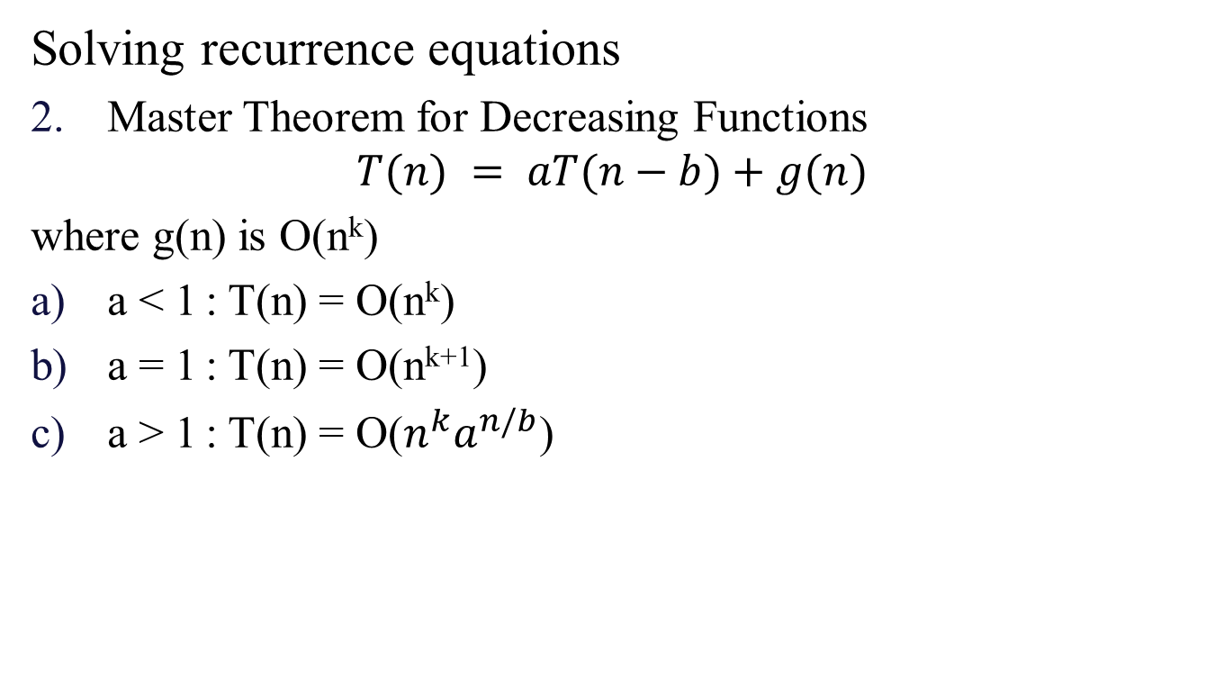
Analyzing Recursive Algorithms
Solving recurrence equations
Master Theorem for Decreasing Functions
$$T(n) = aT(n−b)+g(n)$$
where g(n) is O(n^{k})
a < 1 : T(n) = O(n^{k})
a = 1 : T(n) = O(n^{k+1})
a > 1 : T(n) = O($n^{k}a^{n/b}$)

Slide 40
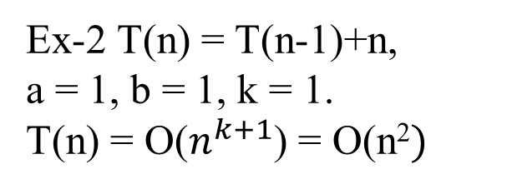
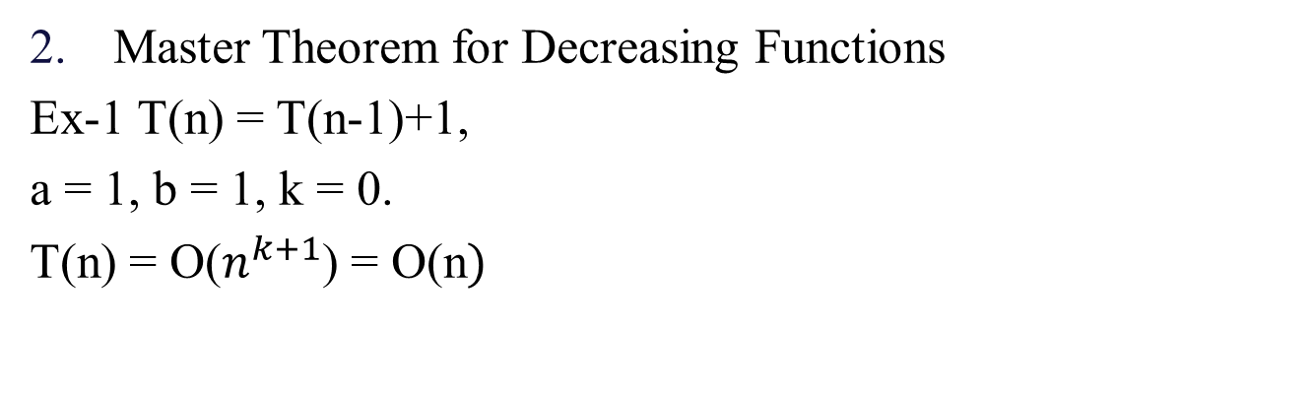
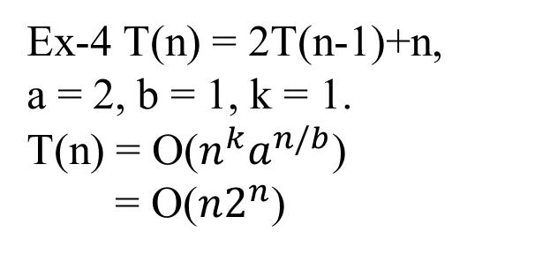
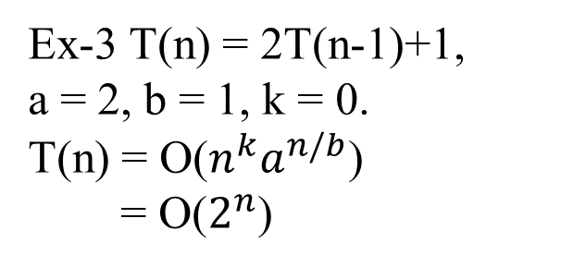
Analyzing Recursive Algorithms
Master Theorem for Decreasing Functions
Ex-1 T(n) = T(n-1)+1,
a = 1, b = 1, k = 0.
T(n) = O($n^{k+1}$) = O(n$)$
Ex-3 T(n) = 2T(n-1)+1,
a = 2, b = 1, k = 0.
T(n) = O($n^{k}a^{n/b}$)
= O($2^{n}$)
Ex-2 T(n) = T(n-1)+n,
a = 1, b = 1, k = 1.
T(n) = O($n^{k+1}$) = O(n²$)$
Ex-4 T(n) = 2T(n-1)+n,
a = 2, b = 1, k = 1.
T(n) = O($n^{k}a^{n/b}$)
= O(${n2}^{n}$)

Slide 41
Case Studies: Analyzing Algorithms
Ex-1
#include <stdio.h>
void main(){
int n=10;
int a[n];
a[3]=5;
printf("%d",a[3]);
}
Ex-2
#include <stdio.h>
void main(){
int n; scanf(“%d”,&n);
int a[n];
for(int i=0;i<n;i++)
scanf("%d",&a[i]);
for(int i=0;i<n;i++)
printf("%d",a[i]);
}
Ex-3
#include <stdio.h>
void main(){
int n; scanf(“%d”,&n);
int a[n];
for(int i=0;i<n;i++)
scanf("%d",&a[i]);
for(int i=0;i<n;i++)
for(int j=0;j<n;j++)
printf("%d",a[i]);
}
Ex-4
#include <stdio.h>
void main(){
int n; scanf(“%d”,&n);
int a[n];
for(int i=0;i<n;i++)
scanf("%d",&a[i]);
for(int i=0;i<n;i++)
for(int j=0;j<n/2;j++)
printf("%d",a[i]);
}

Slide 42
Case Studies: Analyzing Algorithms
Ex-5
int findMinimum(int array[]) {
int min = array[0];
for(int i = 1; i < n; i++){
if (array[i] < min) {
min = array[i];
}
}
return min;
}

Slide 43
Case Studies: Analyzing Algorithms
Ex-6
void fun(int n){
if(n<=0)
return;
printf("%d",n);
fun(n-1);
}
Ex-7
void fun(int n){
if(n<=0)
return;
printf("%d",n);
fun(n/2);
}
Ex-8
void fun(int n){
if(n<=0)___1
return;
for(int i=0;i<k’;i++) ___(k’+1)
fun(n-1); ___k’*T(n-1)
}
(T(n) = 1 + (k'+1) + (k'*(T(n-1)) = k'*T(n-1) + (k’ + 2) ➔ T(n) depends on value of k’ (Master Theorem for Decreasing Functions))
Ex-9
void fun(int n){
if(n>1){ ___1
for(int i=0;i<n;i++) ___(n+1)
printf("%d",i); ___n
fun(n/2); ___T(n/2)
fun(n/2); ___T(n/2)
}
}
T(n) = 1 + (n+1) + n + 2T(n/2) = 2T(n/2) + (2n + 2)
a = 2, b= 2, k = 1, p = 0. O(n log n) as per Master Theorem for Dividing Functions

Slide 44
References
T(n) = 4 ➔ T(n) = O(1)
T(n) = 3 + (n + 1) + n + (n + 1) + n = 4n + 5 ➔ T(n) = O(n)
T(n) = 3 + (n + 1) + n + (n + 1) + (n * (n + 1)) + n*n = 2(n^2) + 4n + 5 ➔ T(n) = O(n^2)
T(n) = 3 + (n + 1) + n + (n + 1) + (n * (n/2 + 1)) + n*n/2 = (n^2) + 4n + 5 ➔ T(n) = O(n^2)
T(n) = 1 + n + n + n + 1 = 3n + 1 ➔ T(n) = O(n)
T(n) = T(n-1) + 2 ➔ T(n) = O(n) Master Theorem for Decreasing Functions
T(n) = T(n/2) + 2 ➔ T(n) = O(log n) Master Theorem for Dividing Functions
T(n) = 1 + (k'+1) + (k'*(T(n-1)) = k'*T(n-1) + (k’ + 2) ➔ T(n) depends on value of k' Master Theorem for Decreasing Functions
T(n) = 1 + (n+1) + n + 2T(n/2) = O(n log n) Master Theorem for Dividing Functions

Slide 45
References
Algorithms Design: Foundations, Analysis and Internet Examples Michael T. Goodrich, Roberto Tamassia, 2006, Wiley (Students Edition)
Data Structures, Algorithms and Applications in C++, Sartaj Sahni, Second Ed, 2005, Universities Press
Introduction to Algorithms, TH Cormen, CE Leiserson, RL Rivest, C Stein, Third Ed, 2009, PHI

Slide 46
Any Question!!

Slide 47
Thank you!!

